Slide 1

Customer Segmentation: Online Retail
A Springboard Capstone Project
Eduardo Mosada Jr.

Slide 2
The Problem:
How can an online retailer target specific groups of customers for its marketing campaigns and strategies based on their purchasing patterns?
Notes:
Customer Segmentation is a valuable tool for businesses, enabling them to align their strategies and tactics more effectively with current and potential customers. In today's marketing landscape, whether in B2B (business-to-business) or B2C (business-to-consumer) contexts, companies segment their customers based on various factors, including demographic, geographic, behavioral, psychographic, and technographic characteristics.The methodologies for customer segmentation are constantly evolving and may differ from one company to another. However, the primary goal of effective customer segmentation analysis is to gain a better understanding of customers' ever-changing needs and behaviors.

Slide 3
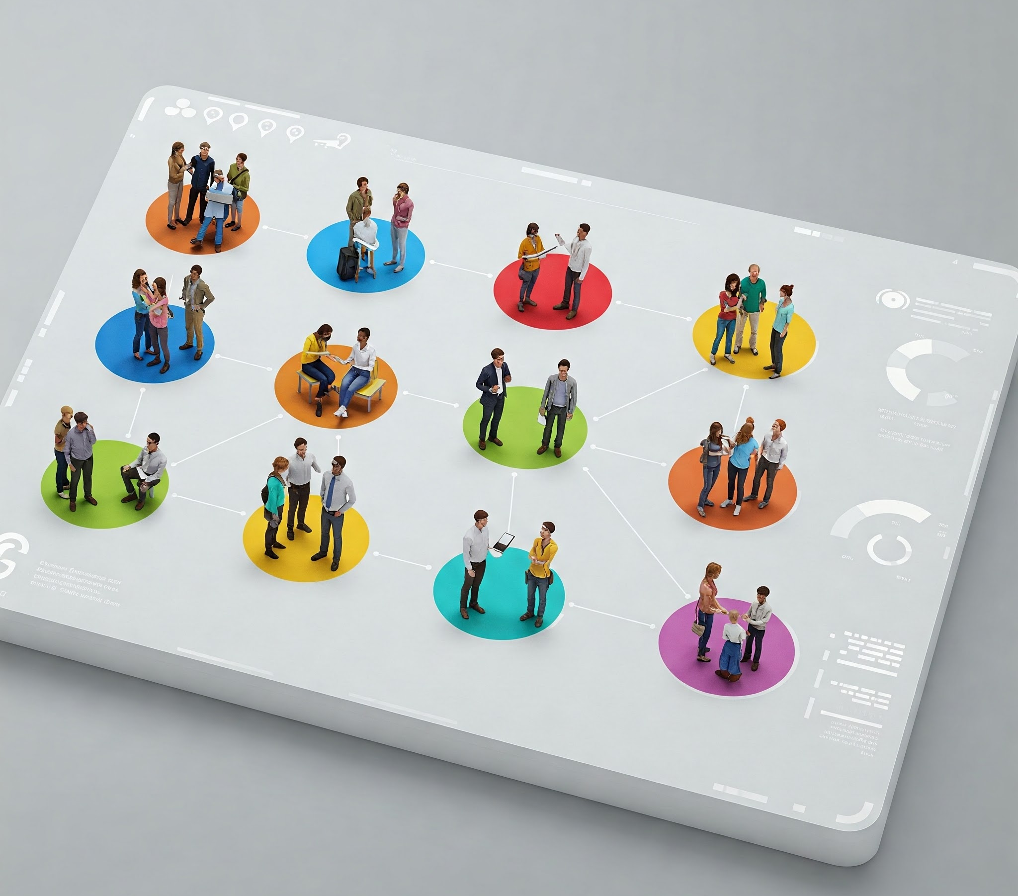
Objectives:
Valuable insights into customer purchasing behavior
Customer-centric data anchored on RFM features
Segmented customers based on RFM analysis.
Benefits:
Better understanding of customers' behaviors and ever-changing needs
Targeted Marketing Campaigns/Strategies
Enhanced Customer Experience
Drive innovative and creative solutions
Boost product sales and profitability
Promising outlook for the future
Notes:
RFM (Recency, Frequency, Monetary) Analysis is a powerful method that enables marketing teams to create targeted campaigns for specific customer segments. These campaigns include offers, messages, and services that are relevant and tailored to customers’ buying patterns and behaviors.
An effective customer segmentation analysis leads to better customer insights, which enable marketing teams to make informed strategic decisions regarding messaging and positioning. This strategic approach fosters innovative and creative solutions that enhance profitability.
This project utilizes machine learning for customer segmentation based on RFM analysis, focusing on three key features: Recency, Frequency, and Monetary value. The analysis aims to uncover valuable insights into customer purchasing behavior and transform the transactional data into a customer-centric dataset through feature engineering and clustering that will effectively aid in segmenting customers, enabling the business to determine appropriate marketing strategies and enhance the customer experience. Additionally, this analysis has the potential to significantly boost product sales, offering a promising outlook for the future.

Slide 4

The Data:
UK-based all-occasion gift-ware online retailer
500,000+ transactions in 2010
4,000+ customers recorded
Data Source: UCI Machine Learning Repository | Online Retail II
Notes:
The dataset contains all transactions for a UK-based online retailer that sells all occasion gift-ware. This e-commerce dataset, made available by the UCI Machine Learning Repository, contains transactions made by customers from 2009 to 2011. This project will work on the latest transactions done in 2010 by approximately 4,300 customers.

Slide 5
Data Wrangling
541,910 Sales transactions in 2010
25 % Blank Customer IDs - 135,080
1.6 % Negative values in quantity – 8,905
1 % Duplicate records – 5,192
72.5%: Records retained – 392,733

Slide 6
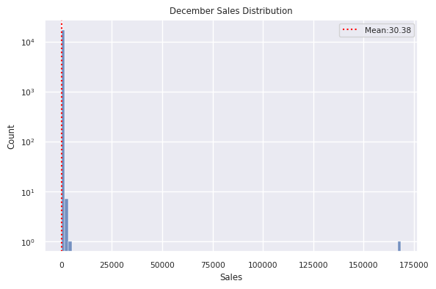
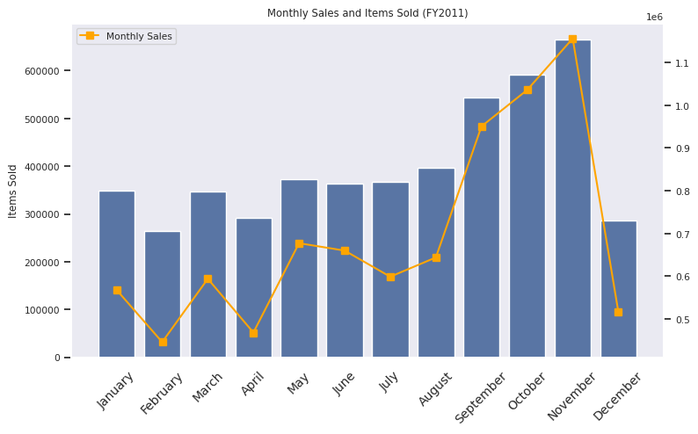
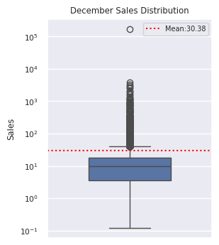
Exploratory Data Analysis
Analysis of 55% Dip in December Sales
392,733 Records for EDA
40 Zero-Priced items
2,560 Out of range Invoices
367,023 Records processed
17,132 Invoices
4,219 Customer IDs
3,596 Stock codes
36 Countries
Huge number of low-value transactions
December only accounted for 5% of the total transactions for the current year
Last transaction is December 9
Incomplete transactions
Notes:
The EDA step revealed 0-priced items and transactions later than December 30, 2010. These records were then removed and the dataset ended up with 367,023 records after dropping those invalid records. Out of the 367,023 records the valid transactions for the whole year can be summarized as follows:
Unique Invoices: 17,132
Unique Countries: 36
Unique StockCodes: 3,596
Unique Customer IDs: 4,219
Exploratory Data Analysis of the monthly sales indicated a steep decline in sales in December was revealed.
Further investigation revealed that the transactions for December was INCOMPLETE and that the latest was captured on the 9th of December which even less than the first half of the month. The total transactions in December only accounted for less than 5% of the whole transactions for the year. Although there was a transaction as high as 168,469.6, much of the sales during the month are in the lower amount.

Slide 7
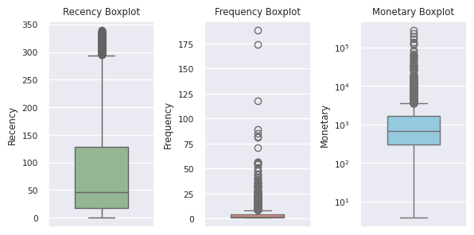
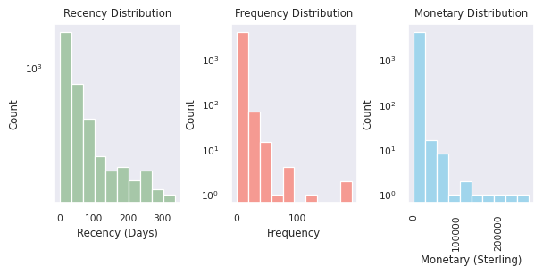
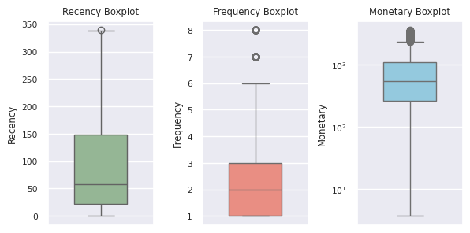
Pre-Processing
Dealing with outliers
Feature Engineering
Recency - How long since the customer's last purchase date?
Frequency - How many transactions did the customer have?
Monetary - How much was spent by the customer?
Outliers for further analysis
402 Monetary outliers
412 Frequency outliers
269 M x F outliers
Non-outliers for modeling
87 % Non-outliers – 3647
3,647 – Scaled data
Notes:
Preprocessing step was initiated by feature engineering the columns to reflect the RFM features per customer - that is:
Recency - How long has it been since the customer's last purchase date? *
Frequency - How many transactions in did the customer have?
Monetary - How much was spent by the customer?
The distribution of data per feature is right-skewed, which indicates presence of outliers.
The focus of this project is on clustering, so only the non-outliers were processed by the model. It is imperative to perform separate analysis on outliers as they represent extreme behaviours by the customers, such as very big spending and very frequent purchases.
The outliers were included in the cluster analysis after modeling:
Monetary outliers: 402
Frequency outliers: 412

Slide 8
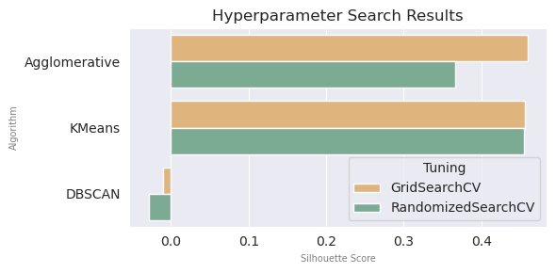

Clustering Algorithm Options
KMeans Clustering
Agglomerative Hierarchical Clustering
DBSCAN
Hyperparameter Search
Pipeline
3 clustering algorithms
2 Cross-Validation (Nested CV)
Scoring function: Silhouette Score
Modeling
Scaler: MinMaxScaler()
Cluster: KMeans | DBSCAN | AHC
Notes:
3 clustering algorithms have been considered for the analysis:
KMeans Clustering
Agglomerative Clustering
DBSCAN
Hyperparameter Search: Nested Cross-Validation
In the Modeling step, three hyperparameter optimization searches were tested accross all three aforementioned algorithms by utilizing the nested cross validation approach to determine the optimal parameters per algorithm.
As the hyperparameter search process cycles through each algorithm, a scoring function is used to determine the their respective silhouette scores.
Hyperparameter Search Results
Out of the model evaluation outcomes, the hyperparameters in KMeans and Agglomerative Hierarchichal Clustering algorithms produced better silhouette scores than DBSCAN on the cross-validation searches.
Given the results, DBSCAN may not be the appropriate clustering algorithm for this dataset since it has negative scores indicating a poor clustering performance (and more overlapping clusters) compared to the two other algorithms that have a higher score.
KMeans algorithm was better suited for clustering the data and thus was chosen for the Modeling process.

Slide 9
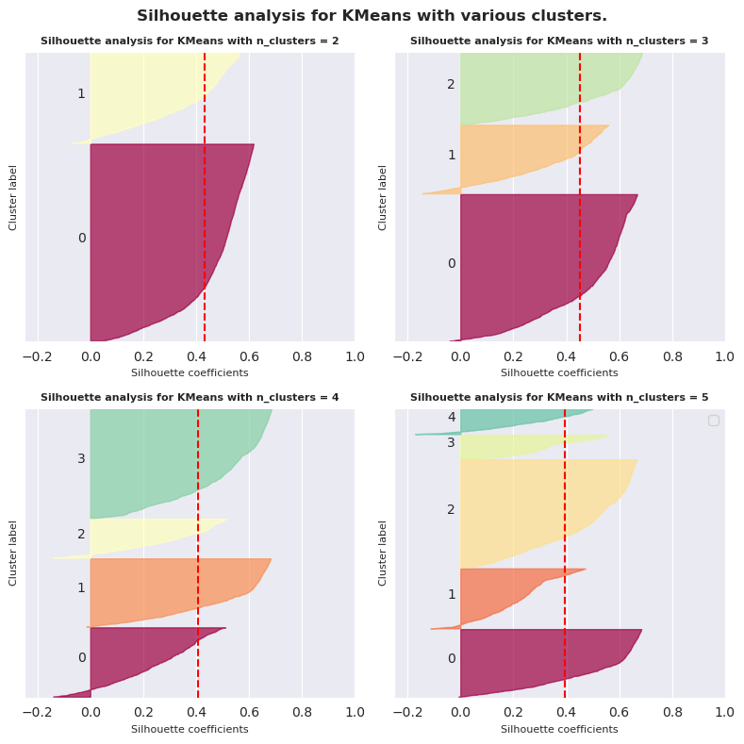
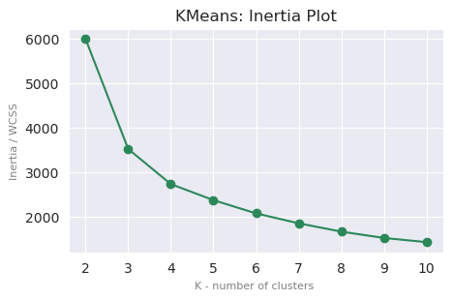
Modeling cont’d.
Cross-Validation vs. Sequential Model-Based Optimization SMBO Search
Optimal K- no. of clusters: Silhouette Analysis
*SMBO using HyperOpt
SMBO hyperparameters:
algorithm : 'lloyd’
init: 'random’
max_iter: 645
n_clusters: 2
n_init: 5
tol: 0.1
Tuning | Inertia | Silhouette Score
SMBO | 5989.735 | 0.432
RandomizedSearchCV | 3521.054 | 0.453
GridSeachCV | 3517.192 | 0.453
Optimal K- no. of clusters : Inertia Plot
-- Elbow point
? Deciding between n_clusters= 3 and 4 -> Silhouette Analysis
Optimal K- no. of clusters: 3
Notes:
Finding the best parameters for KMeans using GridSearchCV, RandomizedSearchCV, and SMBO using Hyperopt returned the following results:
Using the preceding results, SMBO having the highest inertia doesn't necessarily imply that it has the best hyperparameters. Inertia scores decrease as n_cluster increases. The SMBO results with n_clusters = 2 (least loss determined by SMBO's fmin() ) had a unfair advantage over the results of the CVs.
Likewise, the silhouette scores weren't used as the criteria because the results are from the same algorithm - it's only insightful when comparing between two different algorithms.
So what's the criteria?
GridSearch and Randomized CV search methods are relatively inefficient compared to SMBO. In addition, Grid and random searches are completely uninformed by past evaluations and spends significant amount of time evaluating “bad” hyperparameters.
SMBO is generally deemed better as it works by considering the previously seen hyperparameter combinations when choosing the next set of hyperparameters to evaluate; thus, its hyperparameters were used for the subsequent modeling.
As SMBO is deemed the best hyperparameter search method, its corresponding hyperparameters were utilized in the model.
Optimal K no of clusters selection:
The inertia plot was a very useful guide in getting a sense of the best K- no. of clusters. Here it can be surmised that the knee point is in either cluster=3 or cluster 4.
To solidify which is the best among the two options, the silhouette analysis was performed
The inertia plot was a very useful guide in getting a sense of the best K- no. of clusters.
The Silhouette Plot revealed that between n_clusters=3 and n_clusters=4, the former has lesser density in negative silhouette coefficient values, and each of the cluster label height is even better compared to the latter.
The optimal k number of clusters for this data using KMeans algorithm is 3.
KMeans Evaluation Metrics Summary | Pickle files for n_clusters: 2-10

Slide 10
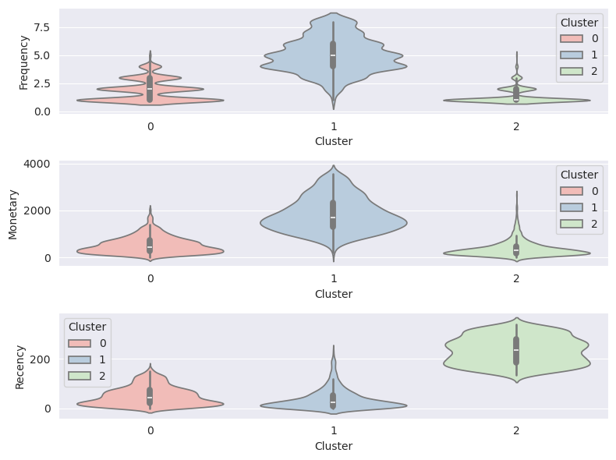
Modeling cont’d.
Cluster Analysis
Assigning Labels
Cluster 0: Moderate
Moderately frequent buyers
Not necessarily high spenders
Majority made recent purchases
Cluster 1: Loyal
Frequent buyers
High spenders
Majority made recent purchases
Cluster 2: At-Risk
Least active recently
Less frequent buyers
Low-spenders
Notes:
Meaningful labels were assigned simply by analyzing the distribution of the clusters in terms of the three key features - Recency, Frequency, and Monetary values.
Starting with Cluster-2, its mean Recency feature is the highest (which is bad) compared to other clusters. In addition, both its mean Frequency and Monetary are the lowest compared to others, so this cluster represents customers who are AT-RISK.
With Cluster-1 having the highest mean in Monetary and Frequency feature, it's easily classified as the loyal customers. They are the customers that constantly or frequently buys items that are either in bulk or higher-value. Note, however, that the mean Recency feature is the lowest, indicating a majority in this cluster made recent purchases.
Cluster-0 placed second in all of the features in terms of its mean values. They are not necessarily big spenders, frequent and recent buyers but the mean values in all three features are not the least.

Slide 11
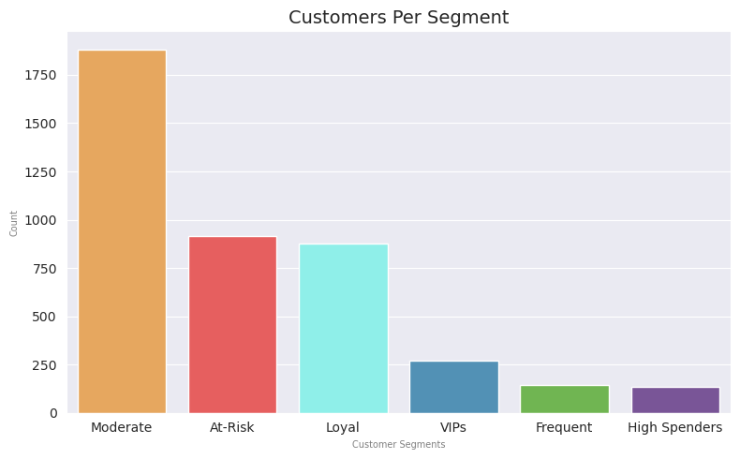
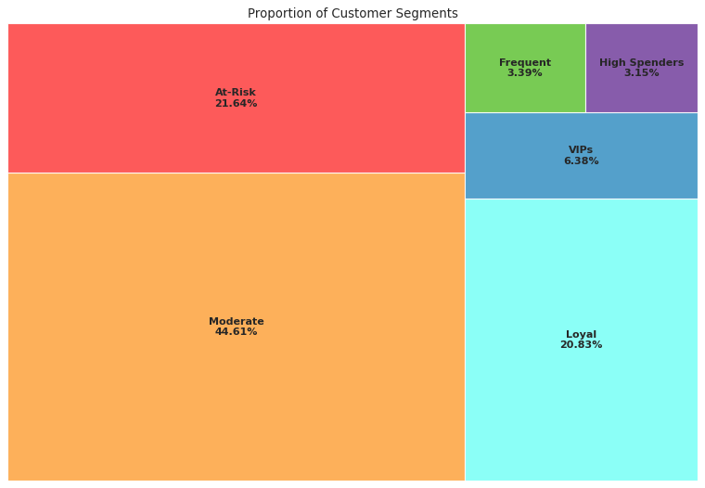
Summary
Customer Segmentation
Customer Segmentation Analysis and Initial Recommendations
Segment | Description | Recommendations
MODERATE | Moderately frequent buyers that are not necessarily high spenders. Majority in this segment made recent purchases. | Offer subscription on frequently bought items (whenever applicable) Recommend "Frequently bought together" items Implement customer retention and loyalty programs
AT-RISK | Least active segment. Less frequent buyers who are low-spenders and have minimal recent purchases. | Requires attention and re-engaging Perform sentiment analysis. Send surveys and ask for reviews or feedback. Identify areas for improvement to enhance the overall buying experience Whenever possible, drop small rewards, such as reactivation bonuses or discounts on their next purchase. Tease or entice with the benefits of becoming active or loyal customers
LOYAL | Frequent buyers who are high spenders, and with its majority having purchased recently. | Implement rewards and loyalty programs, and exclusive perks Run targeted ads for trending items and top items sold Offer subscription on frequently bought items (whenever applicable)
VIPS | High value, frequent buyers. | Offer exclusive perks and vouchers Pamper and enhance the shopping experience by offering expedited or free shipping (whenever applicable)
FREQUENT | Very frequent buyers. | Offer subscription on frequently bought items (whenever applicable) Implement customer retention and loyalty programs Offer expedited or free shipping vouchers (whenever applicable)
HIGH SPENDERS | High-spending buyers | Implement customer retention and loyalty programs Offer discounts on bulk purchases or reaching certain amount (whenever applicable) Enhance customer experience and services
Notes:
The clusters derived from the RFM analysis are presented below, accompanied by initial recommendations from the data scientist. These recommendations will be evaluated and refined by the marketing team and stakeholders in upcoming business reviews and strategic discussions.
Outliers in the data that were extracted earlier during pre-processing were designated as follows:
Monetary outliers : High-Spenders Customers
Frequency outliers : Frequent Customers
Both Monetary and Frequency outliers : VIPs (This is obtained by getting the intersection between Monetary and Frequency Outliers.)

Slide 12

Recommendations and Next Steps:
Evaluate the feasibility of launching targeted marketing campaigns
Develop and periodically monitor KPIs and metrics
Effectiveness of marketing campaigns and new processes
Customer responses and sentiments
> Do KPIs - sales, revenue, and customer engagement/retention - improve over time?
Explore or expand customer segmentation methods beyond RFM analysis
Sentiment Analysis and Recommendation Engines
Omni-channel approach for seamless experience
Innovation – IT landscape transformation to support changes
Notes:
After identifying each cluster and analyzing their respective RFM features, initiate discussions and engage with the marketing team to craft suitable targeted marketing campaigns tailored to each customer segment. This approach will maximize the company's reach and relevance. It is imperative to develop clear metrics to measure the campaign effectiveness of the marketing campaigns and the implementation of new processes. Commit to periodically monitoring progress through regular assessment of customer responses and sentiments, which are some of the key indicators of improved customer satisfaction and retention rates.
Moreover, while RFM analysis forms a solid foundation, the marketing team may also consider exploring additional customer segmentation methods beyond RFM analysis- like demographic and behavioral insights- to gain deeper insights into customer behavior. Implementing sentiment analysis will further illuminate customer perceptions of the company's products and services and reveal opportunities for enhancements and new or additional offerings.
To elevate customer experience further, leverage recommendation engines to provide personalized recommendations. This innovative approach fosters a more engaging buying experience that leads to increased traffic and sales. The potential for increased sales and customer engagement through this strategy is significant, and it's an exciting prospect for the marketing team to explore.
Embracing these strategies may necessitate a re-evaluation of the company's existing data-gathering process to capture deeper customer insights, and a transformation of the current IT landscape is vital to support these changes.

Slide 13
Sources:
Github Project Repository | Customer Segmentation for an Online Retail
Machine Learning Libraries | Scikit-Learn Clustering Hyperopt Hyperparameter Optimization
Data Source | UCI Machine Learning Repository | Online Retail II
Special Thanks:
Jyant Mahara (Springboard Mentor) | https://www.linkedin.com/in/jyant-mahara-95877b93/

Slide 14



Thank you
Eduardo Mosada Jr.
edu.mosada.jr@gmail.com
https://github.com/ds-edu/ https://www.linkedin.com/in/edumosada/

